Slide 1
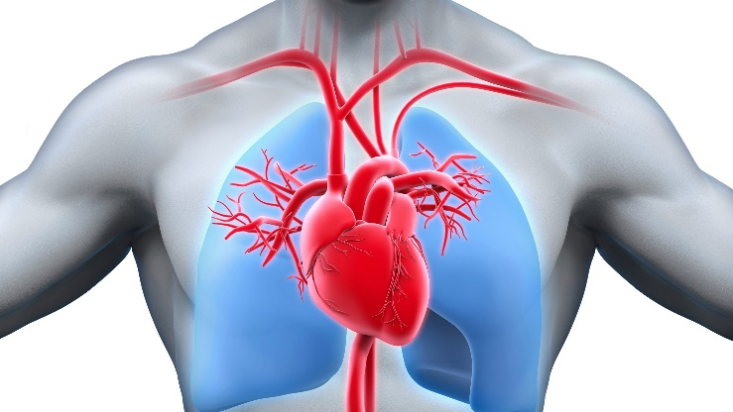
Capstone Project - 3
Cardiovascular Risk Prediction
Manas Ranjan Behera

Slide 2

Point of Discussion
1 - Problem Statement
2 - Introduction
3 - Data Summary
4 - Data Preparation
5 - Data Analysis
6 - Handling Class Imbalance
7 - Confusion Matrix of different Models
8 - Challenges
9 - Conclusion

Slide 3

1.Problem Statement
The dataset is from an ongoing cardiovascular study on residents of the town of Framingham, Massachusetts.
The classification goal is to predict whether the patient has a 10year risk of future coronary heart disease (CHD). The dataset provides the patients’ infor mation. It includes over 4,000 records and 15 attributes.

Slide 4

2.Introduction
Cardiovascular diseases (CVDs) are a group of disorders of the heart and blood vessels.
According to a report by the WHO updated in June, 2021:
Cardiovascular diseases (CVDs) are the leading cause of death globally.
**
An estimated, 17.9 million people died from CVDs in 2019, representing 32% of all global deaths. From these deaths, 85% were due to heart attack and stroke.**
Over three quarters of CVD deaths take place in low-and middle-income countries.

Slide 5

3.Dataset Preparation
Loading the data sets: imported the dataset from google drive
Import Libraries: NumPy, Pandas, Seaborn, Matplotlib, sklearn
etc…

Slide 6
4.Data Summary
Dataset contains 3390 rows, 17 features
Sex: male or female ("M" or "F")
Age: Age of the patient;(Continuous - Although the recorded ages have been truncated towhole numbers, the concept of age is continuous)
is_smoking: whether or not the patient is a current smoker ("YES" or "NO")
Cigs Per Day: the number of cigarettes that the person smoked on average in one day.(can be considered continuous as one can have any number of cigarettes, even half a cigarette.)

Slide 7
Data Summary(Continued…)
BP Meds: whether or not the patient was on blood pressure medication (Nominal)
Prevalent Stroke: whether or not the patient had previously had a stroke (Nominal)
Prevalent Hyp: whether or not the patient was hypertensive (Nominal)
Diabetes: whether or not the patient had diabetes (Nominal)
Tot Chol: total cholesterol level (Continuous)
Sys BP: systolic blood pressure (Continuous)
Dia BP: diastolic blood pressure (Continuous)
BMI: Body Mass Index (Continuous)

Slide 8
Data Summary(Continued…)
Heart Rate: heart rate (Continuous) In medical research, variables such as heart rate though in fact discrete, yet are considered continuous because of large number of possible values.)
Glucose: glucose level (Continuous)
TenYearCHD: 10-year risk of coronary heart disease CHD(binary: “1”, means “Yes”, “0” means “No”)

Slide 9
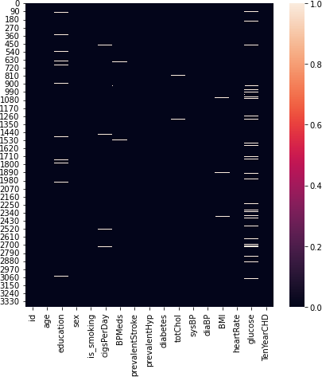
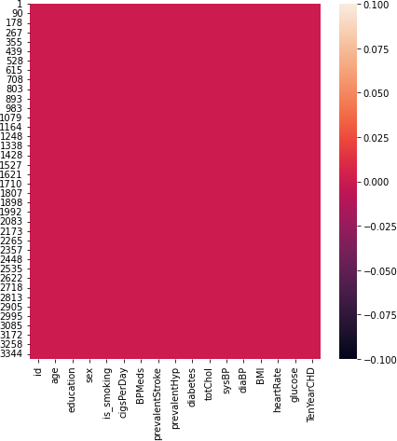
5.Data Analysis
These two plots are showing presence of Null values and after Removing null values From our dataset.

Slide 10
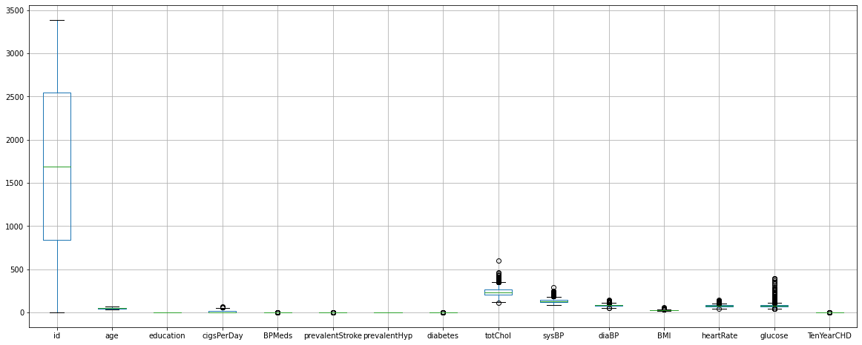
Outlier Detection

Slide 11
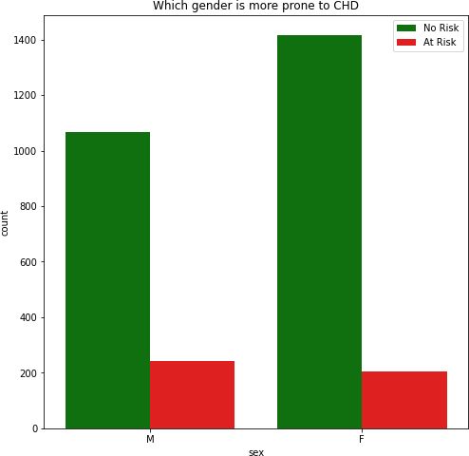
Which gender is more prone to CHD
It is showing that out of 1307 male, around 200 males are having heart disease and out of 1620 females, around 200 females are having heart disease.
It is indicating that males and females with almost coressponding 15% and 12% are suffering from heart disease.

Slide 12
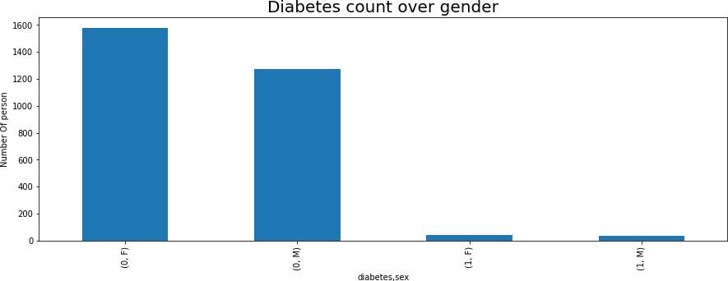
Diabetes count over gender
It is showing that out of 79 diabetes patients 42 are female and 37 male.

Slide 13
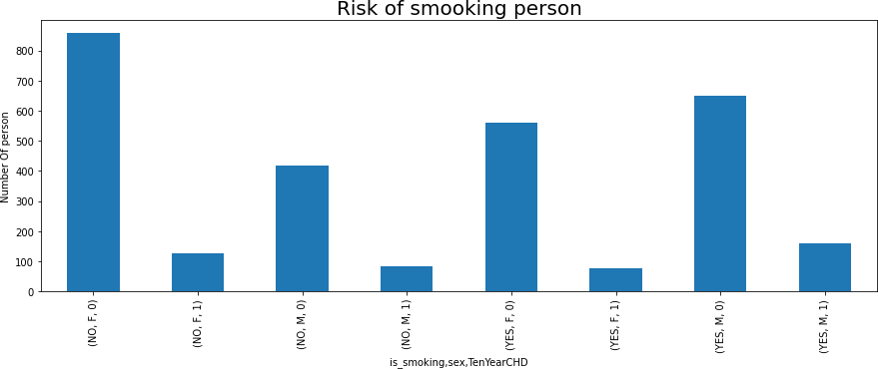
Risk of smooking person
In this dataset out of 1447 smooking persons, total 237 persons are affected by heart disease and out of them 78 are female and 159 are male.

Slide 14
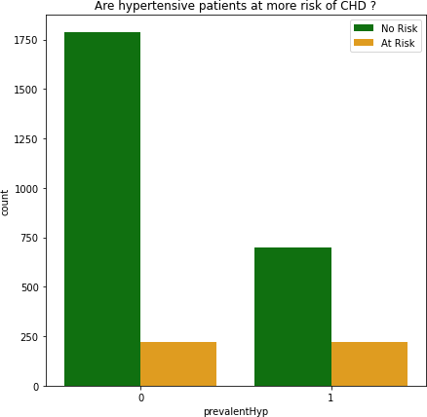
Hypertension wise analysis
From this plot we can say that there is a chance of having heart disease of a person who is going through hypertension, which is an obvious thing.

Slide 15
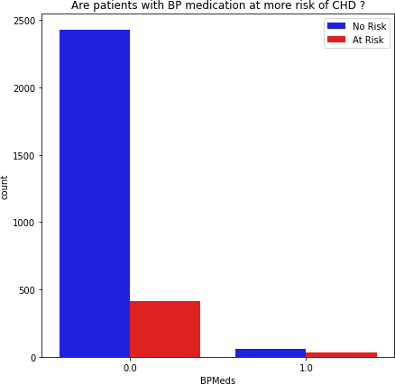
Blood Pressure wise Risk Analysis
This plot showing that if a
person is going through bp,
then there is a higher chance
of having a heart disease.

Slide 16
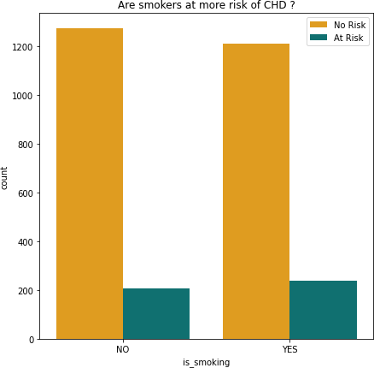
Risk Analysis of Smookers
From this plot we can say that
persons who are not smookers
also at risk of having CHD.

Slide 17
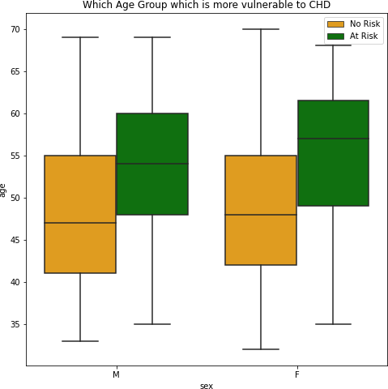
Age Group Wise Analysis
This plot showing that both males and females of age between 50-60 are at risk zone of having CHD.

Slide 18
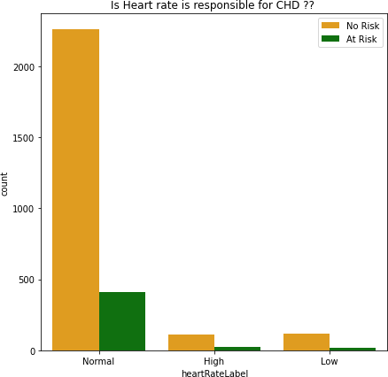
Heartrate Wise Analysis
There are some normal heart rated persons having heart disease.
Heart rate is not responsible for CHD

Slide 19
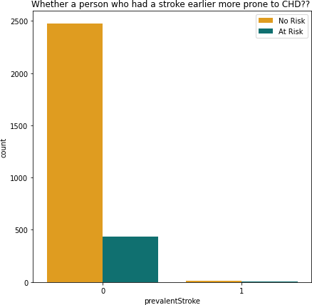
Earlier Heart Stroke Wise Anlysis
Some persons who did not had a stroke earlier also in some sort of having CHD.
So the persons who don’t having earlier stroke can also be at risk.

Slide 20
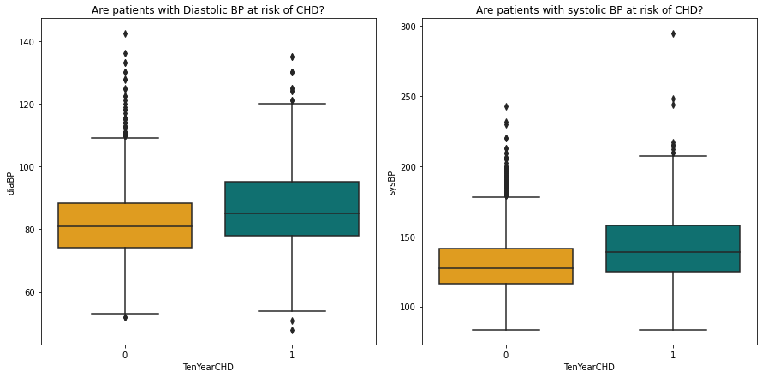
Blood Pressure Wise Analysis
It seems that both numbers are equally important in Monitoring Heart issues.

Slide 21
6.Handling Class Imbalance
To balance the proportion, we have used a technique called SMOTE.
SMOTE : Also called Synthetic Minority Oversampling Technique
It is the technique to make data class balanced.
SMOTE works by selecting examples that are close in the feature space, drawing a line between the examples in the feature space and drawing a new sample at a point along that line.

Slide 22
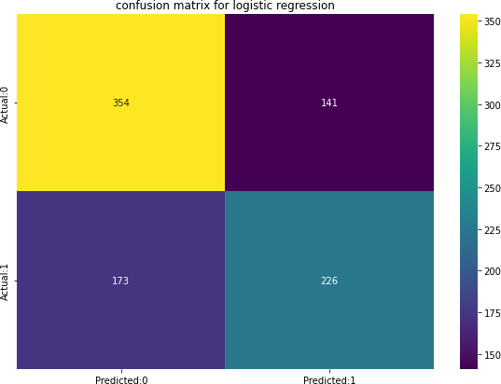
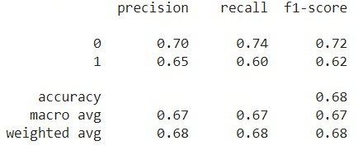
6.Confusion Matrix of different Models
Logistic regression
Accuracy Score = 68.34 %

Slide 23
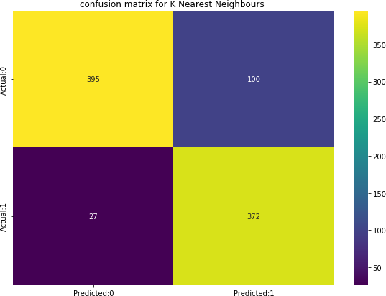
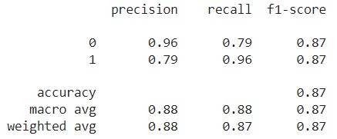
K Nearest Neighbours
Accuracy Score = 85.79 %

Slide 24
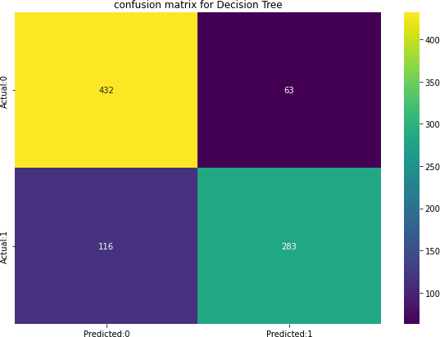
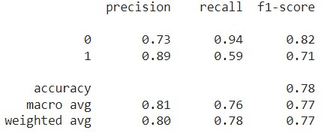
Decision Tree
Accuracy Score = 80%

Slide 25
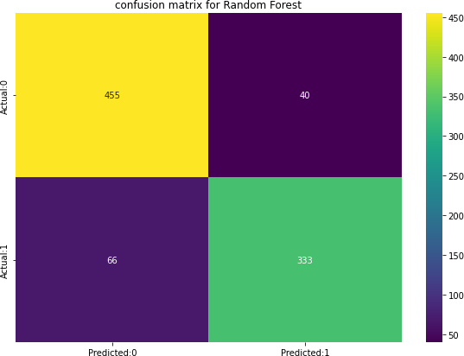
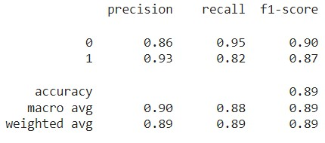
Random Forest
Accuracy Score = 88.14%

Slide 26
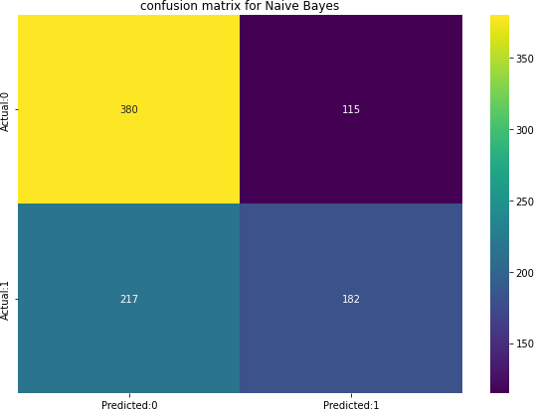
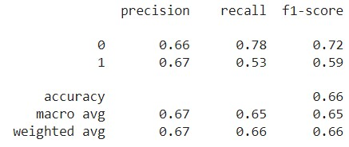
Naive Bayes
Accuracy Score = 62.86 %

Slide 27
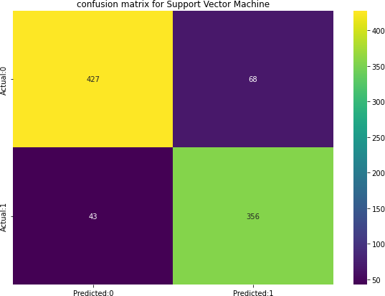
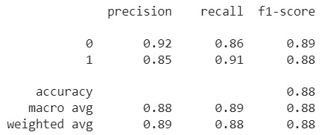
Support Vector Machine
Accuracy Score = 87.58 %

Slide 28
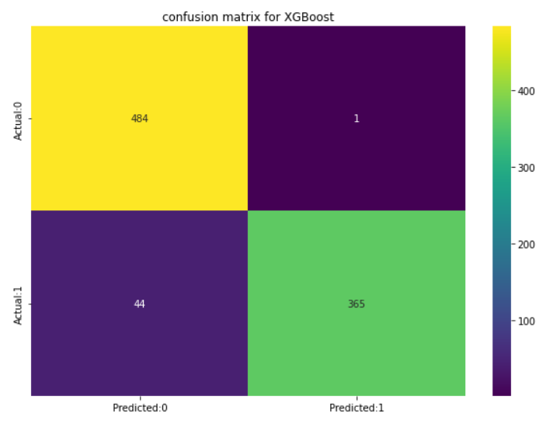
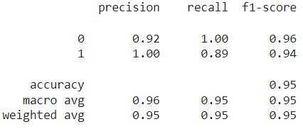
XG Boost
Accuracy Score = 94.96%

Slide 29
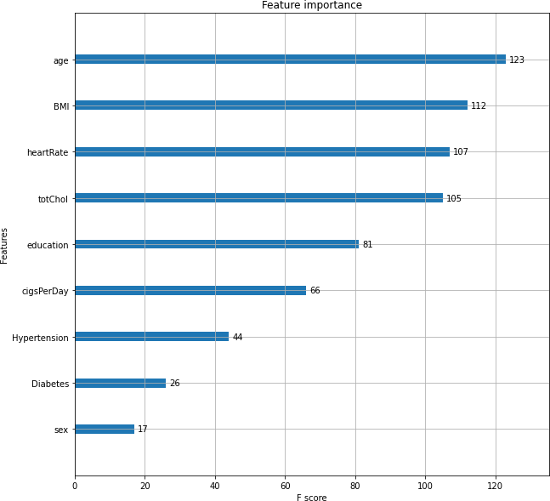
Feature Importance of XGBoost
Age, Total Cholesterol level,
Heartrate were the important
features in the case of
XGBoost Classifier Model.

Slide 30
8.Challenges
This was a class imbalanced dataset so we used SMOTE(Synthetic minority oversampling technique) which is a class imbalance handling technique before running our algorithms.
Did many hyper parameter tunning to get good accuracy.
Decision making on missing value imputations and outlier treatment was quite challenging as well.

Slide 31
9.Conclusion
In this Cardiovascular Risk Prediction Project We tried to fit various models to our dataset to predict the risk of Coronary Heart Disease for next ten years.
Age, Total Cholesterol level, Heartrate were the important features in the case of XGBoost Classifier Model.
Naive Bayes classifier and Logistic Regression were not able to perform well in the prediction of target variable.
XGBoost, Support Vector Machine and Random Forest were better than the rest models.

Slide 32
Thank You

